Slide 1


Coma and serious brain injury: new and old stories
Jenny Kitzinger, Cardiff University
Celia Kitzinger, University of York
International Health Humanities Network,
University of Nottingham
28th June 2013

Slide 2
What I will be talking about:
Media representation of ‘being in a coma’ and ‘recovery’ from a long-term coma - and what clinician say and families witness
The implications of such representations
… and our efforts to create a space for the voices of families e.g. Postcard project

Slide 3
What is a ‘coma’?
Some definitions
Chronic disorders of consciousness: ‘coma’, vegetative [permanent, PVS], minimally conscious state.
Locked-in syndrome (‘The Diving Bell and the Butterfly’)
Brain death

Slide 4
This talk will look at common patterns in representation of long-term coma (not always defined)
Not locked in, not brain dead

Slide 5
Attitudes towards end-of-life issues in Disorders of Consciousness: A European Survey
(Demertzi et al, 2011, J. Neurology)
2,475 medical and paramedical professionals
32 European countries
PVS – 82% preferred not to be kept alive
Chronic MCS – 70% preferred not to be kept alive –
Some consider MCS worse than PVS because patient can feel pain & has fluctuating awareness.
But only 30% considered it acceptable to stop treatment to people in MCS
Notes:
PVS has been renamed “unresponsive wakefulness syndrome”
Chronic MCS = more than one year
Findings in accordance with previous findings showing that the majority of physicians and nurses would refuse treatment for themselves more than for patients (usually around 90% - see table of past surveys in Demertzi et al 2011 Attitutdes towards end-of-lfe issues in disorders of consciousness: A European Survey, J Neurology 258: 1058-1065)
Key American MCS case is Robert Wendland

Slide 6
What would you do if it were you Doctor?
Some neurosurgeons would refuse the life-sustaining interventions that they use on others unless there were much better odds of recovery to functional independence (Barlow & Teasdale, 1986).

Slide 7
Coma
Media
Clinicians
Family

Slide 8
Media: The ‘sleeping beauty’
A study of 30 movies featuring prolonged comas found that actors (with one exception)
all had their eyes closed
remained beautifully groomed, often muscular and tanned.
There was no muscle wastage, contracture, evidence of double incontinence, or even feeding tubes (Wijdicks and Widjicks, 2005)

Slide 9
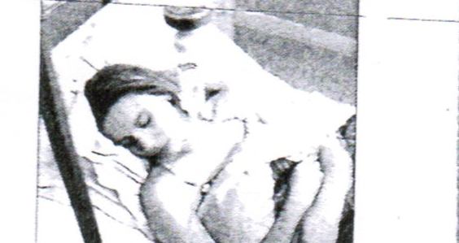
Similar ‘sleeping beauty’ images in press representations
We would add - that film and TV images also show the person ‘still’ and only subject to gentle, non-intrusive actions

Slide 10
Clinicians: Key (current) facts about ‘being in a coma’ from clinical evidence
Person in a long ‘coma’ will be doubly incontinent, have a feeding tube, will be the object of work such as ‘suctioning’ (because they can’t swallow), will develop complications e.g. muscle wastage, spasticity and frequent illnesses such as pneumonia.
Person in PVS may ‘look’ like they are experiencing pain (new uncertainty?), person in MCS can definitely experience pain. Bedside examination may misdiagnose MCS patient as PVS

Slide 11
Families:
Distressing ‘reflexes’ , distress and pain
Physical deterioration and complications (e.g. spasticity)
Indignity and lack of choice

Slide 12
A mother’s description
“Most of the artists drew beautiful sketches, because the public wanted to think of her as a 'sleeping beauty'. they always painted her with long hair [...] While the newspapers called my daughter ‘the sleeping beauty’ I sat by my daughter’s bed... A medical description in the court describes her 'emaciated, curled up in what is known as doeskin contracture, every joint was bent…”
(Quinlan and Quinlan, 1977, 215-222)

Slide 13
(Apparent?) Suffering
“Her head would forever be moving from side to side, and her face began to grimace...it was terribly disturbing to watch. Her mouth would open wide, as though she were trying to scream, but the only sound you would hear, sometimes, was a moan. This was the hardest of all to bear, because we felt Karen must be in pain. Some deep, awful pain …”

Slide 14
“Unlike the "sleeping beauty" depicted in newspaper articles and sketches drawn by artists who had never got a glimpse of Karen, she was not resting quietly. As time went on, her body began to take on distinctive patterns. Karen would thrash wildly at times, she would blindly resist treatments and the machines she was attached to, yet all the while unable to communicate and respond to voices of her loved ones.”
[Quinlan and Quinlan, 1977 and http://www.karenannquinlanhospice.org/history.htm]

Slide 15
“even I could see that there were movements, reactions to pain for example, I’d go ‘golly, this isn’t what you see on the telly about coma’. [Later, on being told brother was MCS] before then I’d held on to the idea that even though I’d begun to see inklings that he might, I thought, be experiencing things, that was just an illusion and that he was vegetative and that therefore he was protected from pain. I kept hoping that I was going through trauma and anxiety and distress, but he, fingers crossed, wasn’t. So it was just ghastly.” (relative of MCS patient)
Notes:
Explict contrast to meida

Slide 16
“There is nothing [in his life]. Other than, let’s see, the panic when the trachy is being suctioned out. […] it would be different if that patient wasn’t suffering. If it was like you see in the films and they was just laying there all nice you know, asleep looking, calm, nice, no choking, no fits, nothing like that. [His mother said] ‘you’re helping with the torture of him’ (Relative of vegetative patient)
Notes:
Explicit contrast to media

Slide 17
Distress and pain
“She has suffered. She’s had a lung collapsed, she’s had C Diff [clostridium difficile] five times […] She was forced to wear splints that mark her legs, mark her arms, put on a tilt table which was terrifying for her. […] And her hands are crippled, you’ve got to straighten them and that’s painful for her - you know her limbs are stiff. That’s painful for her but she can’t tell me to get off.” (Relative of PVS daughter)

Slide 18
Indignity and lack of choice
“She hasn’t got a choice. I can remember my Mum being ill and my Mum saying “I don’t want this any more”, “I don’t want any more.” And she had that choice. […]
The ones that don’t survive are the lucky ones. They’re definitely the lucky ones. […] I know if she had the choice it’s not what she would want.”

Slide 19
Recovery
Media
Clinicians
Family

Slide 20
Media: Recovery?
Factual reports: Death or Recovery - or ‘breakthrough communication moments’ e.g. the ‘Hi Mom’ or miracles
Fiction often shows death or a full and rapid recovery.
Notes:
For written version – the death after coma

Slide 21
Fiction: soap opera or detective drama - recoveries with minor memory loss, Hollywood films superheroes
e. g. ‘Kill Bill’ or ‘Hard to Kill’

Slide 22
Clinicians: recovery
Very occasionally ‘miracles’, some amazing stories of determined recovery (from short coma)
recovery of some consciousness, ‘Hi mom’ moment can be ‘emergence’ from VS to MCS
(b) recovery of full consciousness but….

Slide 23
can sometimes emerge into full consciousness after years or even decades in MCS (Fins et al, 2007). However, likely to have profound mental and physical impairments even when fully ‘awake’ (Katz et al, 2009).
E.g recover consciousness without regaining the ability a full ability to communicate or to make sense of the world around them.

Slide 24
Families: Imagined awakenings
“You’ve watched so many films where people wake up “Oh, where am I?” and I think that was probably still in my head somewhere. [Relative of MCS patient]
“We thought she was in a proper coma – that you’re just completely asleep in, and then one day you wake up, if that makes sense… And I think for a long, long time we still thought that could happen.” [Relative of PVS patient]

Slide 25
Imagined recoveries
“ I didn’t realise how dependent she would be on others for physical movement. Everything. And I didn’t actually realise that she wouldn’t eventually be able to go to the loo herself. […] What do they call that – incontinence I suppose. […] And she’s lost her speech too. […] And I never imagined she wouldn’t be able to eat. I never imagined she would be fed through a tube.”

Slide 26
Imagined recoveries
“in the beginning, I just thought, when she wakes up properly, she's going to be as she was. […]– or that she would maybe have a limp, or she would stutter, or there would be something like that. I never, for one moment, thought that she would be completely paralysed, you know, and not able to talk. Not able to eat or drink or ... you know? That just wasn't— A disability, yes, you know, but not – you know, nothing on this scale …” [Relative of PVS daughter]

Slide 27
Some actual awakenings
she remained in a coma for about three months. But there wasn’t a moment when she suddenly woke up from it. It’s not like in a film, huh! There was a gradual pretty horrific awakening where she sort’v slowly: started emerging. Physically and mentally unrecognizable from what she’d been before. [Relative of ‘emerged’ patient]

Slide 28
Reactions to ‘Kill Bill’
“ There’s a movie called Hard to Kill, and he gets shot and he goes into a coma for seven years. And this gorgeous doctor goes and looks after him. He’s lying there with his hair all long and he doesn’t have a catheter or obviously nothing going on, and this doctor she even goes “oh please do come back, you’ve got so much to come for”. Well I’m barfing, oh my God. Next thing his eyes start flickering, and a few minutes later he’s tackling people with his walking stick.
And he was lying there looking all tanned and as gorgeous as Steven Segal can look, and you just thought how dare you trivialise this kind of thing? – there must be so many people like [my husband] who suffered anoxic or hypoxic brain injury who have never even gotten the chance at rehab and who were just sitting in a nursing home somewhere.”

Slide 29
Why it matters
Lack of representation of (and appropriate services for) people living with this most profound of disabilities – patients and their carers.
Lack of social support and understanding
“If only I’d known then, what I know now”

Slide 30
What we are now trying to do about it…
Creating alternative cultural representatins
The Postcard Project
The HealthTalkOnline website

Slide 31
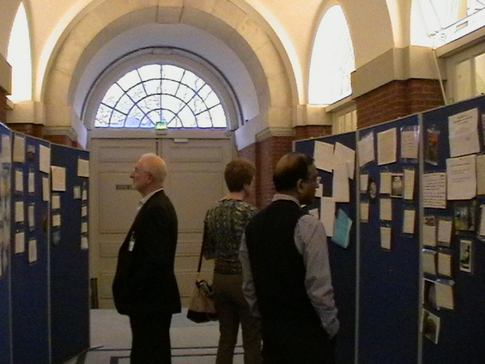
End here

