Slide 1



AHRC Health and Music Workshop
Professor Paul Crawford

Slide 2

Health Humanities: The evolution of Medical Humanities
A more inclusive, outward-facing and applied discipline
Not just medical
Relevant to allied health professionals, carers, service-users, self-carers

Slide 3
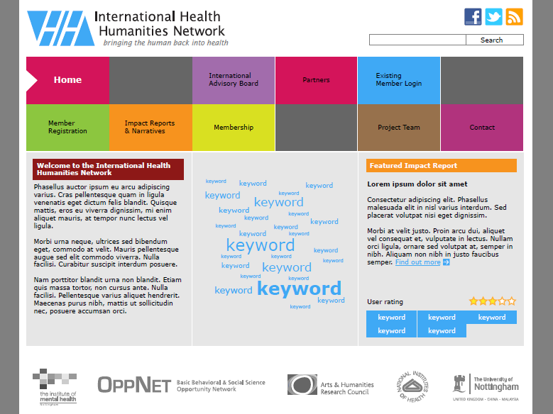
  www.healthhumanities.org
  (due April 2012)

Slide 4
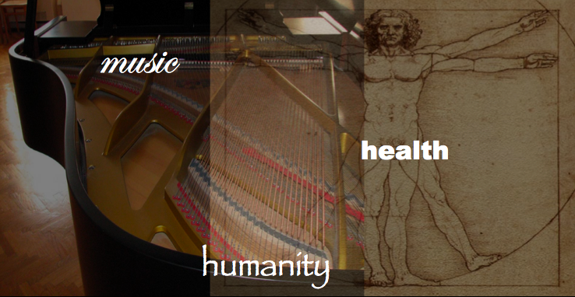





For additional information, please contact Dr. Brian Abrams
email: abramsb@mail.montclair.edu
Phone: +1 973 655 3458
SECOND INTERNATIONAL
HEALTH HUMANITIES CONFERENCE
Music, Health, and Humanity
9, 10, 11 August, 2012
Montclair State University
New Jersey, United States

