Slide 1
Rhythm for Life Music and wellbeing in older adulthood
Centre for Performance Science
Royal College of Music

Slide 2
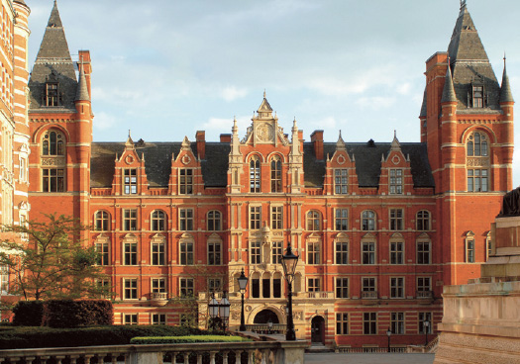
Centre for Performance Science

Slide 3
Research
Knowledge exchange
Teaching

Slide 4
Research
Knowledge exchange
Teaching

Slide 5
Research areas
Applied music psychology and physiology
Musical development, education and expertise
Social and economic sciences of music
Application of new technology in music learning, creating and performing

Slide 6
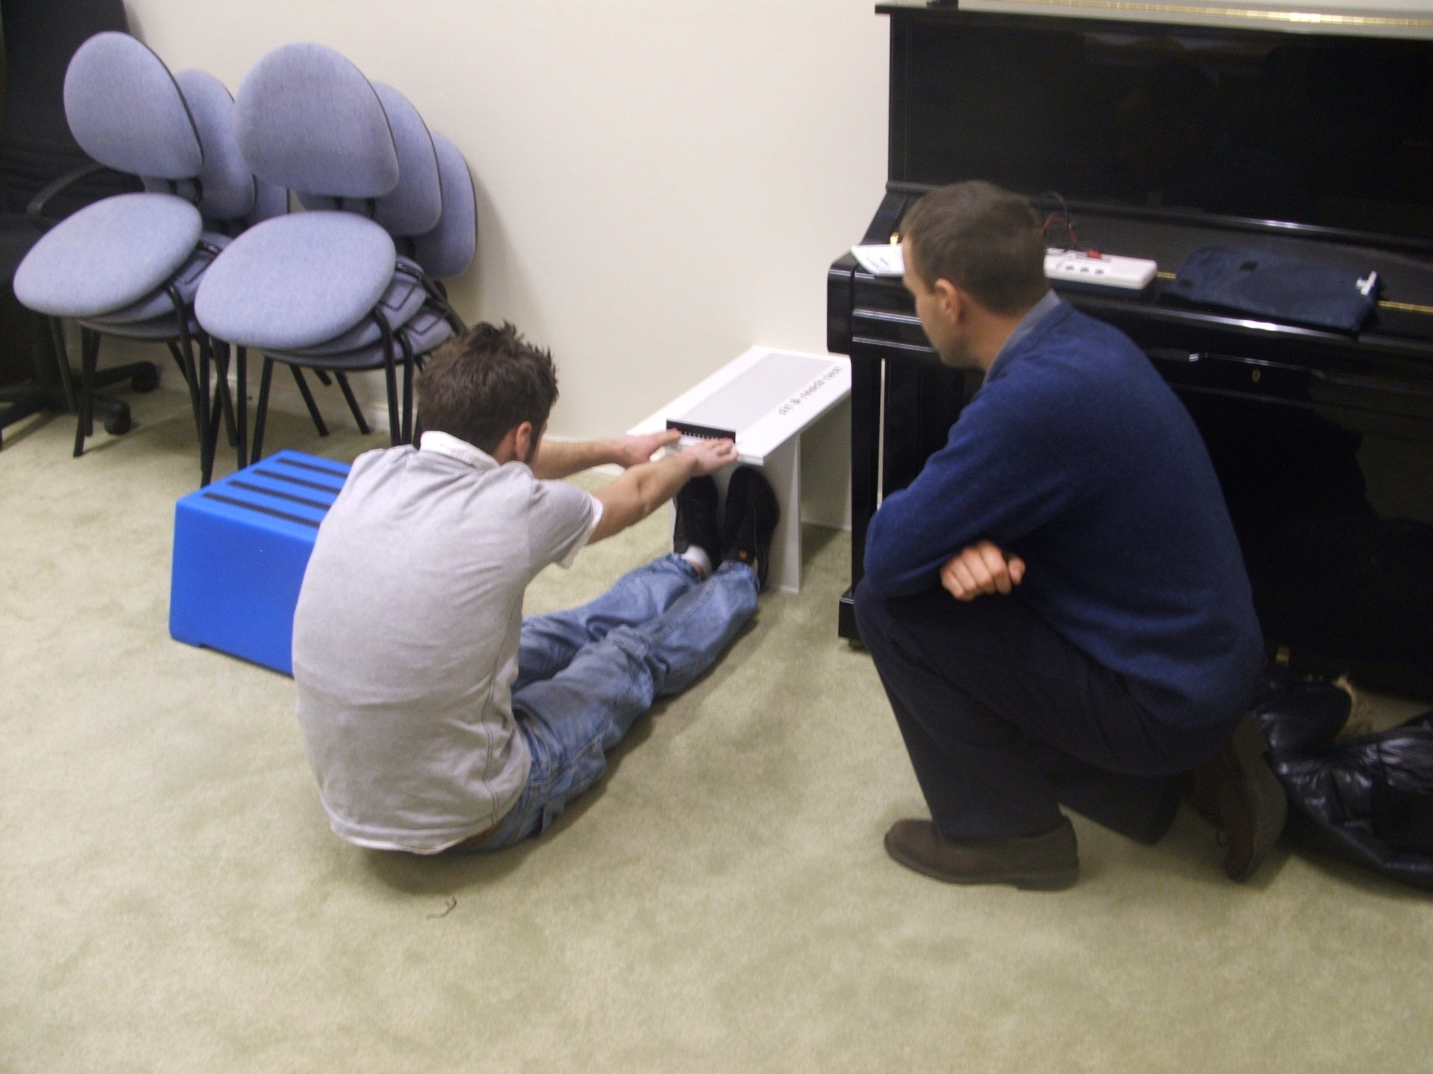
Fitness awareness scheme

Slide 7
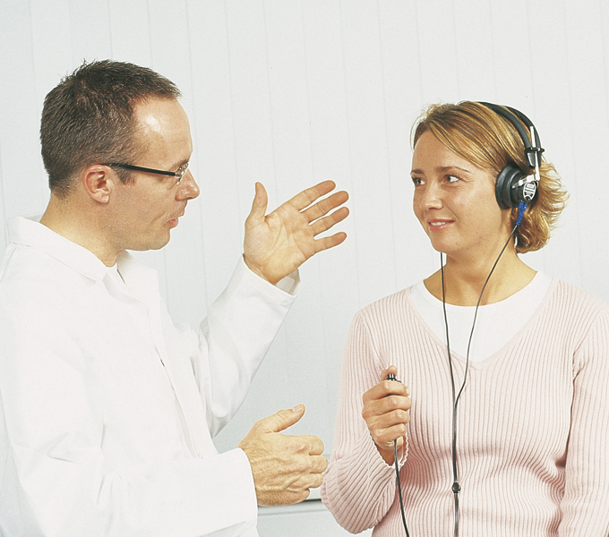
Hearing awareness scheme

Slide 8
Research
Knowledge exchange
Teaching

Slide 9
Teaching
BMus modules in Performance science and psychology
MSc in Performance science *NEW*
MSc in Performing arts medicine with UCL *NEW*
PhD (or DMus) in Performance science

Slide 10
Research
Knowledge exchange
Teaching

Slide 11
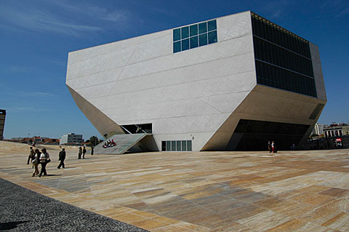
International Symposium on Performance Science 2007
Casa da Música
Porto | Portugal

Slide 12

ISPS 2009
University of Auckland
Auckland | New Zealand

Slide 13

ISPS 2011
University of Toronto
Toronto | Canada

Slide 14

ISPS 2013 VIENNA
www.performancescience.org

Slide 15

Rhythm
for
Life
Research
Knowledge exchange
Teaching

Slide 16
Overview
Context
Methods
Questionnaire results
Interview results

Slide 17
Overview
Context
Methods
Questionnaire results
Interview results

Slide 18
Healthy ageing is…
“the process of optimising opportunities for physical, social and mental health to enable older people to take an active part in society without discrimination and to enjoy an independent and good quality of life.”
Health is more than the absence of illness.
Swedish National Institute of Public Health (2007), Healthy Ageing: A Challenge for Europe

Slide 19
Wellbeing
Hedonic perspective: Subjective experience of happiness and life satisfaction.
Eudaimonic perspective: Positive psychological functioning, good relationships and self-realisation.
Tennant et al. (2007), WEMWBS: Development and UK validation, Health and Quality of Life Outcomes, 5 (63)

Slide 20
Five ways to wellbeing
Connect with others.
Be active.
Taking notice of your surroundings.
Give to others and the community.
Learn something new.
Nef (2011), Five Ways to Wellbeing: New Applications, New Ways of Thinking

Slide 21
Five ways to wellbeing
Connect with others.
Be active.
Taking notice of your surroundings.
Give to others and the community.
Learn something new.
Nef (2011), Five Ways to Wellbeing: New Applications, New Ways of Thinking

Slide 22
Musical experiences…
are a powerful part of older adults’ lives (Cohen et al. 2002).
are sources of positive emotions and satisfy important psychological needs (Laukka 2007).
facilitate connections with spirituality, the maintenance of physical and cognitive skills, subjective experiences of good health, connections with self and others, and the understanding and expression of self (Hays 2005).

Slide 23
Making music…
decreases anxiety, depression and loneliness (Koga & Timms 2001).
increases cognitive functioning (Bugos et al. 2007).

Slide 24
Singing…
increases perceptions of overall physical health and decreases loneliness (Cohen 2006).
enhances positive affect, focused attention, deep breathing, social support, cognitive stimulation and regular commitment (Clift & Hancox 2010).

Slide 25
However…
There is little current UK research exploring the effects of learning a musical instrument (rather than singing) on wellbeing.
Intervention-style studies have tended to focus only on quantitative measures of health, rather than the phenomenology of good health and subjective wellbeing.

Slide 26
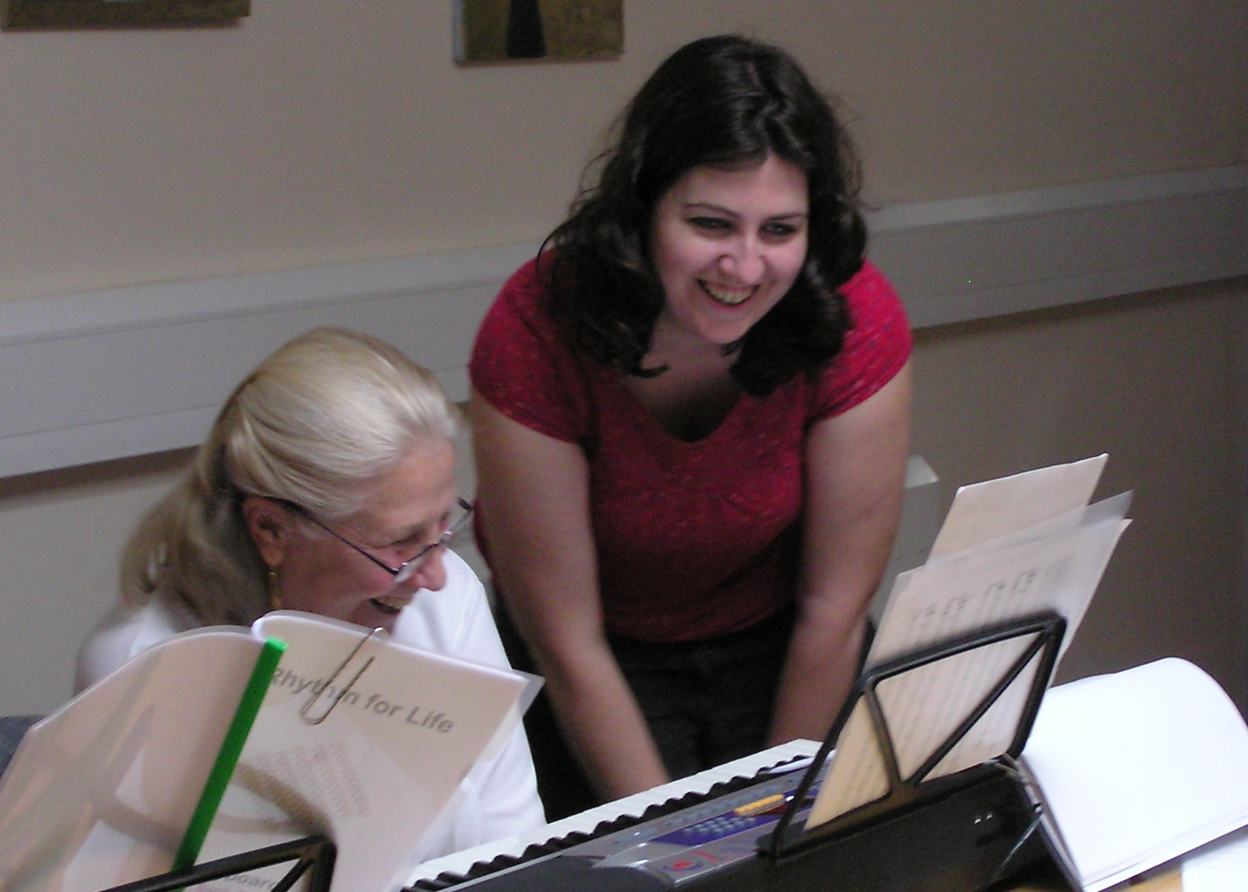
Rhythm for Life
Aim: To enhance wellbeing among older adults through the implementation and evaluation of creative music-making packages delivered by young musicians
Rhythm
for
Life
Notes:
Aim
Why are we doing it? 1) Music-making often limited; 2) research on listening not practice
Novel – 3-pronged approach: (1) new instrumental provision for older adults, (2) concurrent evaluation and refinement of this provision, and (3) development of the employability of conservatoire music students

Slide 27
Research question
In what ways can learning to make music in older adulthood contribute to subjective wellbeing?

Slide 28
Overview
Context
Methods
Questionnaire results
Interview results

Slide 29
Participants
Group | N | Age (SD) | Sex
Experimental | 68 | 68.00 (9.32) | 51 women, 17 men
Comparison | 30 | 67.55 (7.40) | 23 women, 5 men, 2 NR

Slide 30
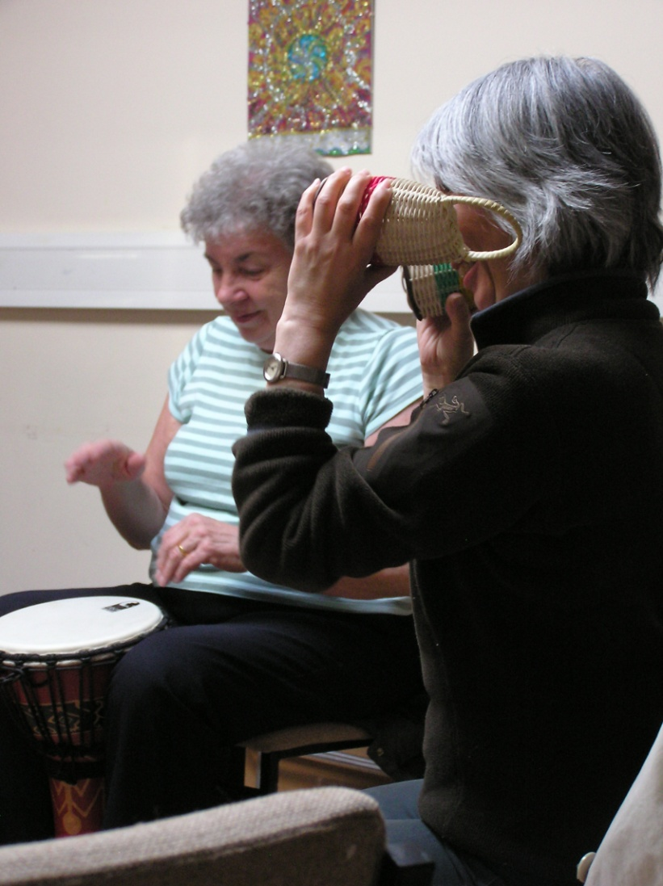
Programmes
Work Package 1
1-to-1 and small groups
April-July 2010 and 2011
Work Package 2
Creative workshops
Oct-Dec 2010 and 2011
Video link

Slide 31
Procedure
Demographics | WEMWBS | HPLP
1-to-1 lessons
N=21 (13 women, 8 men) Age=67.57 (8.74)
Interviews | WEMWBS | HPLP
Experimental
group
Small group lessons
N=32 (26 women, 6 men) Age=69.88 (9.85)
Creative workshops
N=15 (12 women, 3 men) Age=64.60 (8.43)
Comparison group
U3A activities
N=30 (23 women, 5 men, 2 NR) Age=67.55 (7.40)

Slide 32
Wellbeing
Warwick-Edinburgh Mental Wellbeing Scale
Short 7-item version
Hedonic and eudaimonic perspectives

Slide 33
Health promotion (HPLP II)
Subscale | Example
Health responsibility
Physical activity
Nutrition
Interpersonal relations
Spiritual growth
Stress management
Notes:
The HPLPII measures the frequency of engagement in health-promoting behaviours. It consists of 52 items that are rated on a four-point Likert-type scale: 1 (never), 2 (occasionally), 3 (frequently) and 4 (routinely). Scores for all items thus range from 52 to 208 with a midpoint of 130. This instrument provides a total score for health-promoting behaviour, as well as six subscales.

Slide 34
Health promotion (HPLP II)
Subscale | Example
Health responsibility | Discuss my health concerns with health professionals (n=9).
Physical activity
Nutrition
Interpersonal relations
Spiritual growth
Stress management
Notes:
The HPLPII measures the frequency of engagement in health-promoting behaviours. It consists of 52 items that are rated on a four-point Likert-type scale: 1 (never), 2 (occasionally), 3 (frequently) and 4 (routinely). Scores for all items thus range from 52 to 208 with a midpoint of 130. This instrument provides a total score for health-promoting behaviour, as well as six subscales.

Slide 35
Health promotion (HPLP II)
Subscale | Example
Health responsibility | Discuss my health concerns with health professionals (n=9).
Physical activity | Follow a planned exercise programme (n=8).
Nutrition
Interpersonal relations
Spiritual growth
Stress management
Notes:
The HPLPII measures the frequency of engagement in health-promoting behaviours. It consists of 52 items that are rated on a four-point Likert-type scale: 1 (never), 2 (occasionally), 3 (frequently) and 4 (routinely). Scores for all items thus range from 52 to 208 with a midpoint of 130. This instrument provides a total score for health-promoting behaviour, as well as six subscales.

Slide 36
Health promotion (HPLP II)
Subscale | Example
Health responsibility | Discuss my health concerns with health professionals (n=9).
Physical activity | Follow a planned exercise programme (n=8).
Nutrition | Eat 3-5 servings of vegetables every day (n=9).
Interpersonal relations
Spiritual growth
Stress management
Notes:
The HPLPII measures the frequency of engagement in health-promoting behaviours. It consists of 52 items that are rated on a four-point Likert-type scale: 1 (never), 2 (occasionally), 3 (frequently) and 4 (routinely). Scores for all items thus range from 52 to 208 with a midpoint of 130. This instrument provides a total score for health-promoting behaviour, as well as six subscales.

Slide 37
Health promotion (HPLP II)
Subscale | Example
Health responsibility | Discuss my health concerns with health professionals (n=9).
Physical activity | Follow a planned exercise programme (n=8).
Nutrition | Eat 3-5 servings of vegetables every day (n=9).
Interpersonal relations | Touch and am touched by people I care about (n=9).
Spiritual growth
Stress management
Notes:
The HPLPII measures the frequency of engagement in health-promoting behaviours. It consists of 52 items that are rated on a four-point Likert-type scale: 1 (never), 2 (occasionally), 3 (frequently) and 4 (routinely). Scores for all items thus range from 52 to 208 with a midpoint of 130. This instrument provides a total score for health-promoting behaviour, as well as six subscales.

Slide 38
Health promotion (HPLP II)
Subscale | Example
Health responsibility | Discuss my health concerns with health professionals (n=9).
Physical activity | Follow a planned exercise programme (n=8).
Nutrition | Eat 3-5 servings of vegetables every day (n=9).
Interpersonal relations | Touch and am touched by people I care about (n=9).
Spiritual growth | Am aware of what is important in my life (n=9).
Stress management
Notes:
The HPLPII measures the frequency of engagement in health-promoting behaviours. It consists of 52 items that are rated on a four-point Likert-type scale: 1 (never), 2 (occasionally), 3 (frequently) and 4 (routinely). Scores for all items thus range from 52 to 208 with a midpoint of 130. This instrument provides a total score for health-promoting behaviour, as well as six subscales.

Slide 39
Health promotion (HPLP II)
Subscale | Example
Health responsibility | Discuss my health concerns with health professionals (n=9).
Physical activity | Follow a planned exercise programme (n=8).
Nutrition | Eat 3-5 servings of vegetables every day (n=9).
Interpersonal relations | Touch and am touched by people I care about (n=9).
Spiritual growth | Am aware of what is important in my life (n=9).
Stress management | Pace myself to prevent tiredness (n=8).
Notes:
The HPLPII measures the frequency of engagement in health-promoting behaviours. It consists of 52 items that are rated on a four-point Likert-type scale: 1 (never), 2 (occasionally), 3 (frequently) and 4 (routinely). Scores for all items thus range from 52 to 208 with a midpoint of 130. This instrument provides a total score for health-promoting behaviour, as well as six subscales.

Slide 40
Overview
Context
Methods
Questionnaire results
Interview results

Slide 41
Wellbeing (all)
*

Slide 42
Health promotion (all)
*
*
*
*

Slide 43
Wellbeing (by group)
* interaction

Slide 44
Overview
Context
Methods
Questionnaire results
Interview results

Slide 45
Categories of effects
Subjective experiences of pleasure
Enhanced social interactions
Musically-nuanced engagement in daily life
Fulfilment of musical ambition
Ability to make music
Self-satisfaction through musical progress

Slide 46
1. Experiences of pleasure
“We always seem to be in a really good mood. It just made you feel happy I think being part of something like that.” [5K]
“I feel happier. I don’t get into depression moods so easily.” [14R]
“It sorts of bring that life back into you. I can't explain it properly, but it’s like lighting a candle in your life again.” [7K]

Slide 47
2. Enhanced social interactions
In groups: “I know some people, I met people, and you, the teacher and the organizer and the people from your group…maybe I meet them again, I feel that I now know some people in London because before that almost I don't know anybody here, and that is a great positive thing in my life – being in touch with other people.” [6K]

Slide 48
2. Enhanced social interactions
In personal life: “My objective is to play some music to my wife and to sing to my wife. She is in a nursing home, and although she has got all sorts of the mental problems about Parkinson’s and so on, the one thing that seems to be okay is her presence and her personality. She is there, she’s not dead in that sense. So, that gives me some encouragement to do something… The good part about the music is that it has the potential to involve not only groups but also, in the particular case of my wife, where I want to be able to give her something and she is able to respond in a certain way to give to me because if she could sing along with me it would be great.” [16R]

Slide 49
3. Engagement in daily life
“What I found mostly is I started looking out for rhythm around me and listening to beats, and it was like, you feel happy, smile on your face, and you start being aware of your surroundings… Sound is very important, everything around is frequency, you start being aware of that when you focus on music and instruments. It brings a different, another dimension, to everyday routine.” [14R]

Slide 50
3. Engagement in daily life
“I think it makes you feel, also I mean I hadn't been feeling very well in recent times and getting myself out and going to that, it sort of cheered me up. It brings you out of yourself doesn’t it. I think if you’re ever feeling a bit down or got some problem you forget about it for a little while because you are having a bit of fun.” [5K]

Slide 51
4. Musical fulfilment
“Everybody in the family played an instrument, and I was the only one who didn’t, and I felt, kind of always felt a little left out. So when this came up I said well maybe I start, this is good.” [14R]
“It’s like giving a new lease of life, that’s what I felt. And it will be something to look forward to, something for yourself that you’ve always wanted to do, but you’ve got the opportunity there, a shack of window being opened.” [7K]

Slide 52
5. Ability to make music
“I got so excited over that…to actually hear myself, you know, I could actually recognize something I was playing… It’s when you can actually produce something, I couldn’t believe it you know.” [7K]
“I’m still in awe of musicians, but maybe slightly less because some of the fog has been removed. I realize it’s possible if I did keep at it.” [13K]

Slide 53
6. Self-satisfaction
“[It] sort of makes you feel good about yourself because you have achieved it. So even if it is a small piece, you know a short piece, if you can do it right, if you can do it well you feel as if you have achieved something and it makes it, definitely gives you the feel good factor.” [8K]

Slide 54
6. Self-satisfaction
“Well, it gives me personal involvement with music and a way of concentrating on certain pieces and the satisfaction of knowing that I am making some progress, however slow, in the special subject of my choice.” [15R]

Slide 55
Hedonic wellbeing
Subjective experiences of pleasure
Eudaimonic wellbeing
Enhanced social interactions
Engagement in daily life
Musical fulfilment
Ability to make music
Self-satisfaction
Five ways to wellbeing
Connect with others. ✓
Be active. ✓
Taking notice of your surroundings. ✓
Give to others and the community. ✓
Learn something new. ✓
Learning to make music
One very good way to wellbeing?
Make music!
Video link

Slide 56
Centre for Performance Science Royal College of Music
www.rcm.ac.uk/RhythmforLife

