Slide 1
Ecopoetry, Healing and Public Health:
The case of Ted Hughes
Terry Gifford
Bath Spa University
Universidad de Alicante

Slide 2
‘Art [i]s perhaps this – the psychological component of the autoimmune system. It works on the artist as a healing. But it works on others, too, as a medicine.’ (Paris Review interview 1995: 82)

Slide 3
So we found the end of our journey.
So we stood, alive in the river of light
Among the creatures of light, creatures of light.
‘That Morning’
River

Slide 4
‘Most people I talk to seem to defend or rationalise the pollution of water. They think you’re defending fish or insects or flowers. But the effects on otters and so on are indicators of what’s happening to us. It isn’t a problem of looking after the birds and bees, but of how to ferry human beings through the next century. The danger is multiplied through each generation. We don’t really know what bomb has already been planted in the human system.’ (Morrison interview 1993: 34)

Slide 5
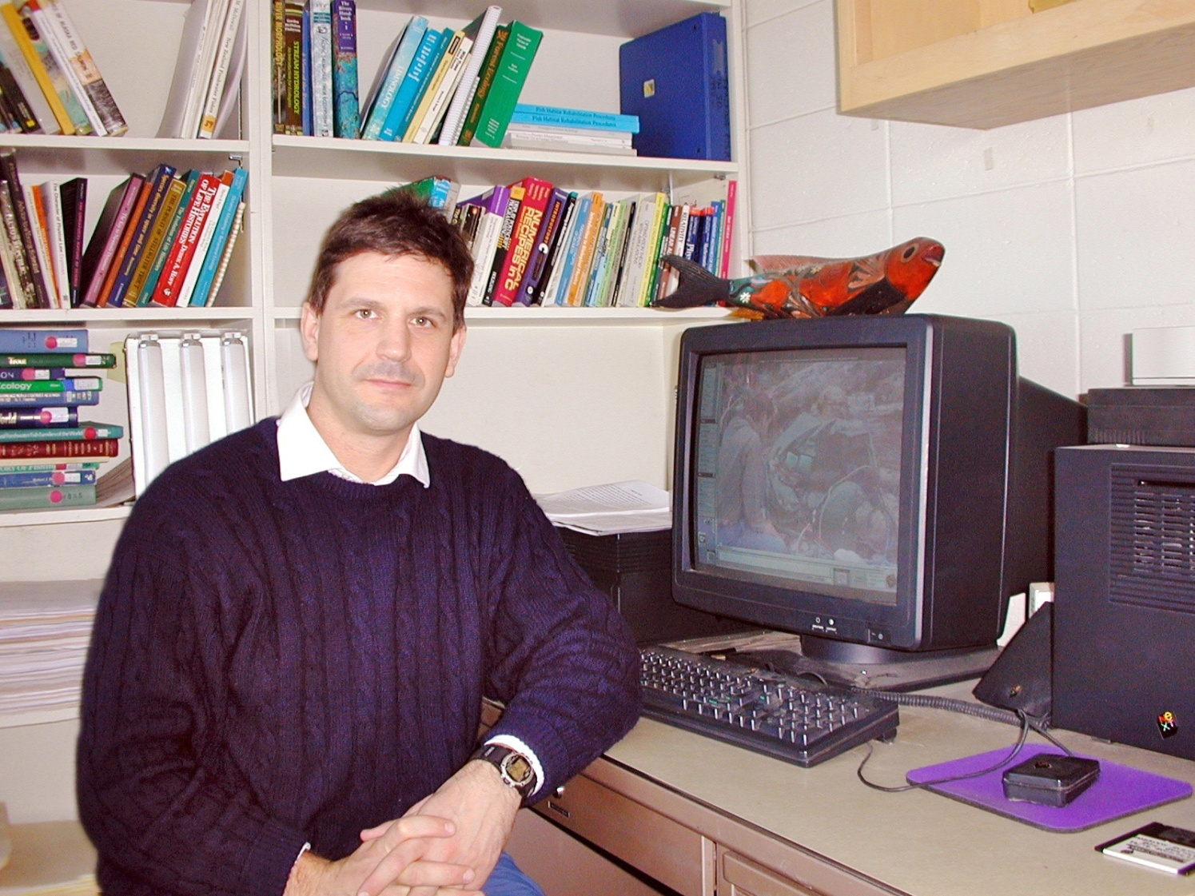
Nicholas Hughes Memorial Page
http://www.sfos.uaf.edu/memorial/hughes/

Slide 6
Four phases of Hughes’s Work
Satires of self-deceptive protections from nature – culture resisting nature, unsuccessfully – some overwhelming encounters with ‘the war between vitality and death’: ‘Egghead’, The Hawk in the Rain (1957).
Mythic narratives of the loss of the ego, dismemberment, and marriage of humbled self with nature – ‘the goddess of complete being’: Cave Birds (1978).
Celebrations of culture embedded in nature (its growth and decay) and of nature including culture: River (1983)
Release in Alcestis (1999)and Birthday Letters (1998).

Slide 7
Aspects of cultural healing in Hughes
Shamanic self-healing and its social function
Hughes’s poems on illness
Reconnecting Cartesian dualisms: ‘the goddess of complete being’
Science and art underpinning the poetry and prose (art and activism)
Concern for nature is concern for human health, multidimensional

Slide 8
Poems on illness
My one or two fleeting glimpses of what it’s like, to know you’ve somehow got yourself so ill, gave me a good idea of the rage against yourself, & the fright. Ted Cornish always says – the worst (he thinks, the most dangerous) thing about such illnesses is the fear. He thinks if you can control the fright – the imagining of the worst & the resignation, you can get the upper hand, & come out of it. On confidence in miracles. (Letters 471)

Slide 9
‘Hands’ (Moortown, 1979: 67)
Hands more of a piece with your tractor
Than with your own nerves,
Having no more compunction than dung-forks,
But suave as warm oil inside the wombs of ewes,
And monkey delicate
At that cigarette
Which glowed patiently through all your labours
Nursing the one in your lung
To such strength, it squeezed your strength to water
And stopped you.

Slide 10
‘I know well’ (Gaudete, 1977: 190)
And I had to lift your hand for you
While your chin sank to your chest
With the sheer weariness
Of taking away from everybody
Your envied beauty, your much-desired beauty
Your hardly used beauty
Of lifting away yourself
From yourself
And weeping with the ache of the effort

Slide 11
Poetry and Public Health

Slide 12
Torridge Action Group
I’ve been involved in a local battle, of sorts, over Bideford Sewage system. The Water Authority, mightily leaned on by local building interests, are putting in a type of sewage system that merely screens the sewage (takes out 20% “solids” – mostly cardboard, plastic etc […] 1600 new houses go in immediately.
9 March 1984

Slide 13
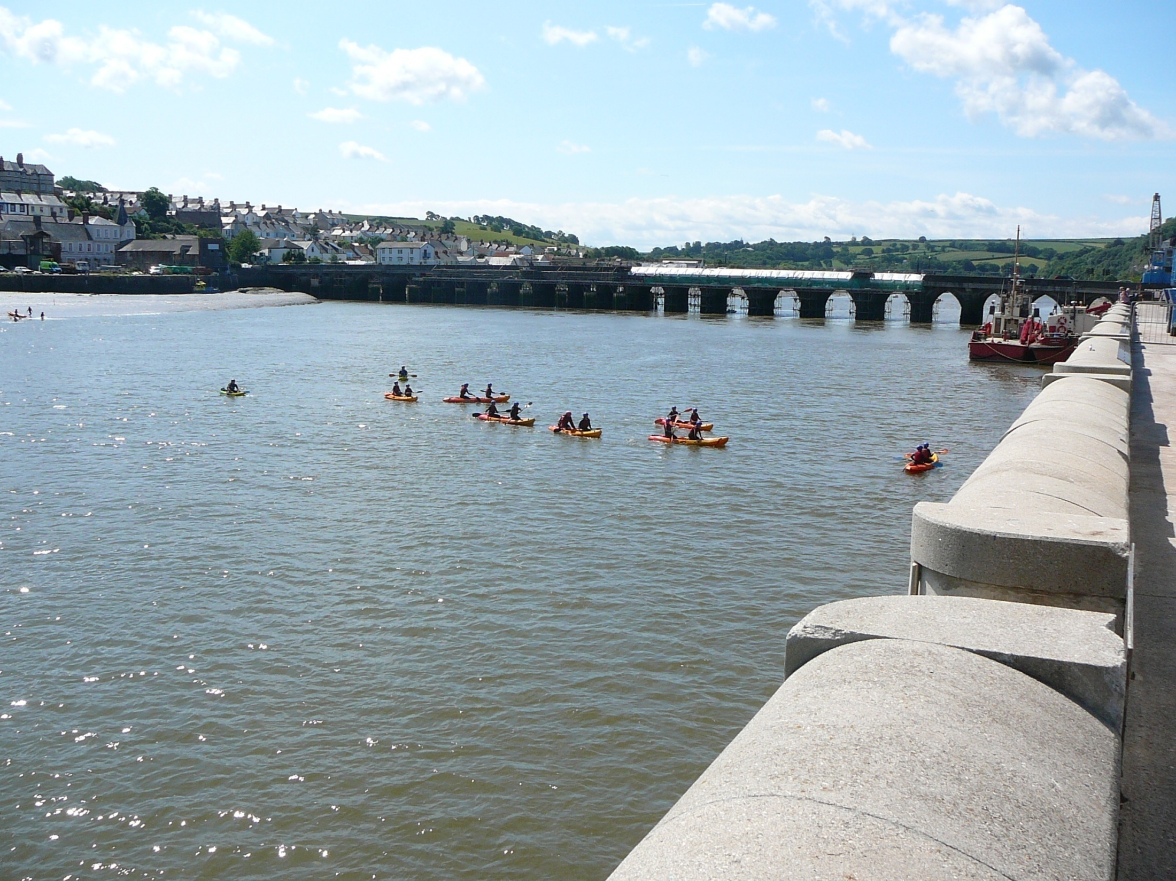

Slide 14
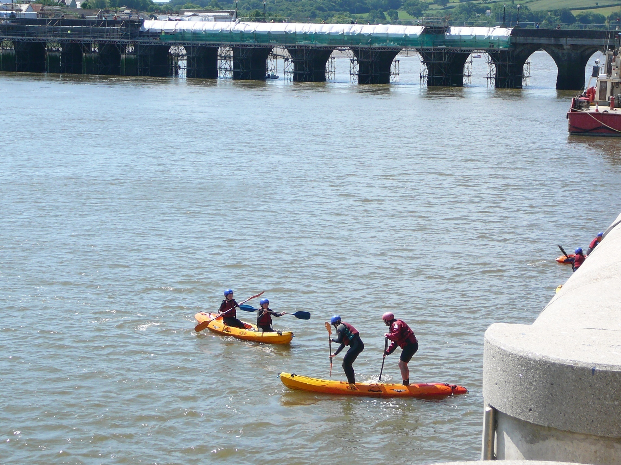

Slide 15
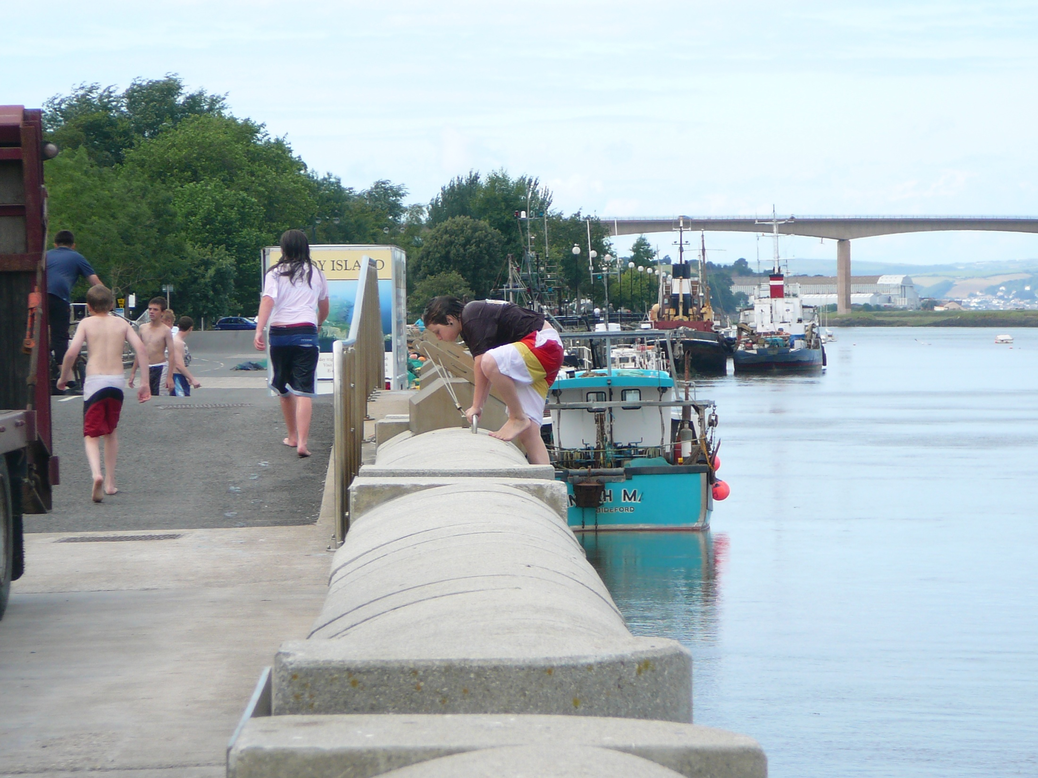

Slide 16
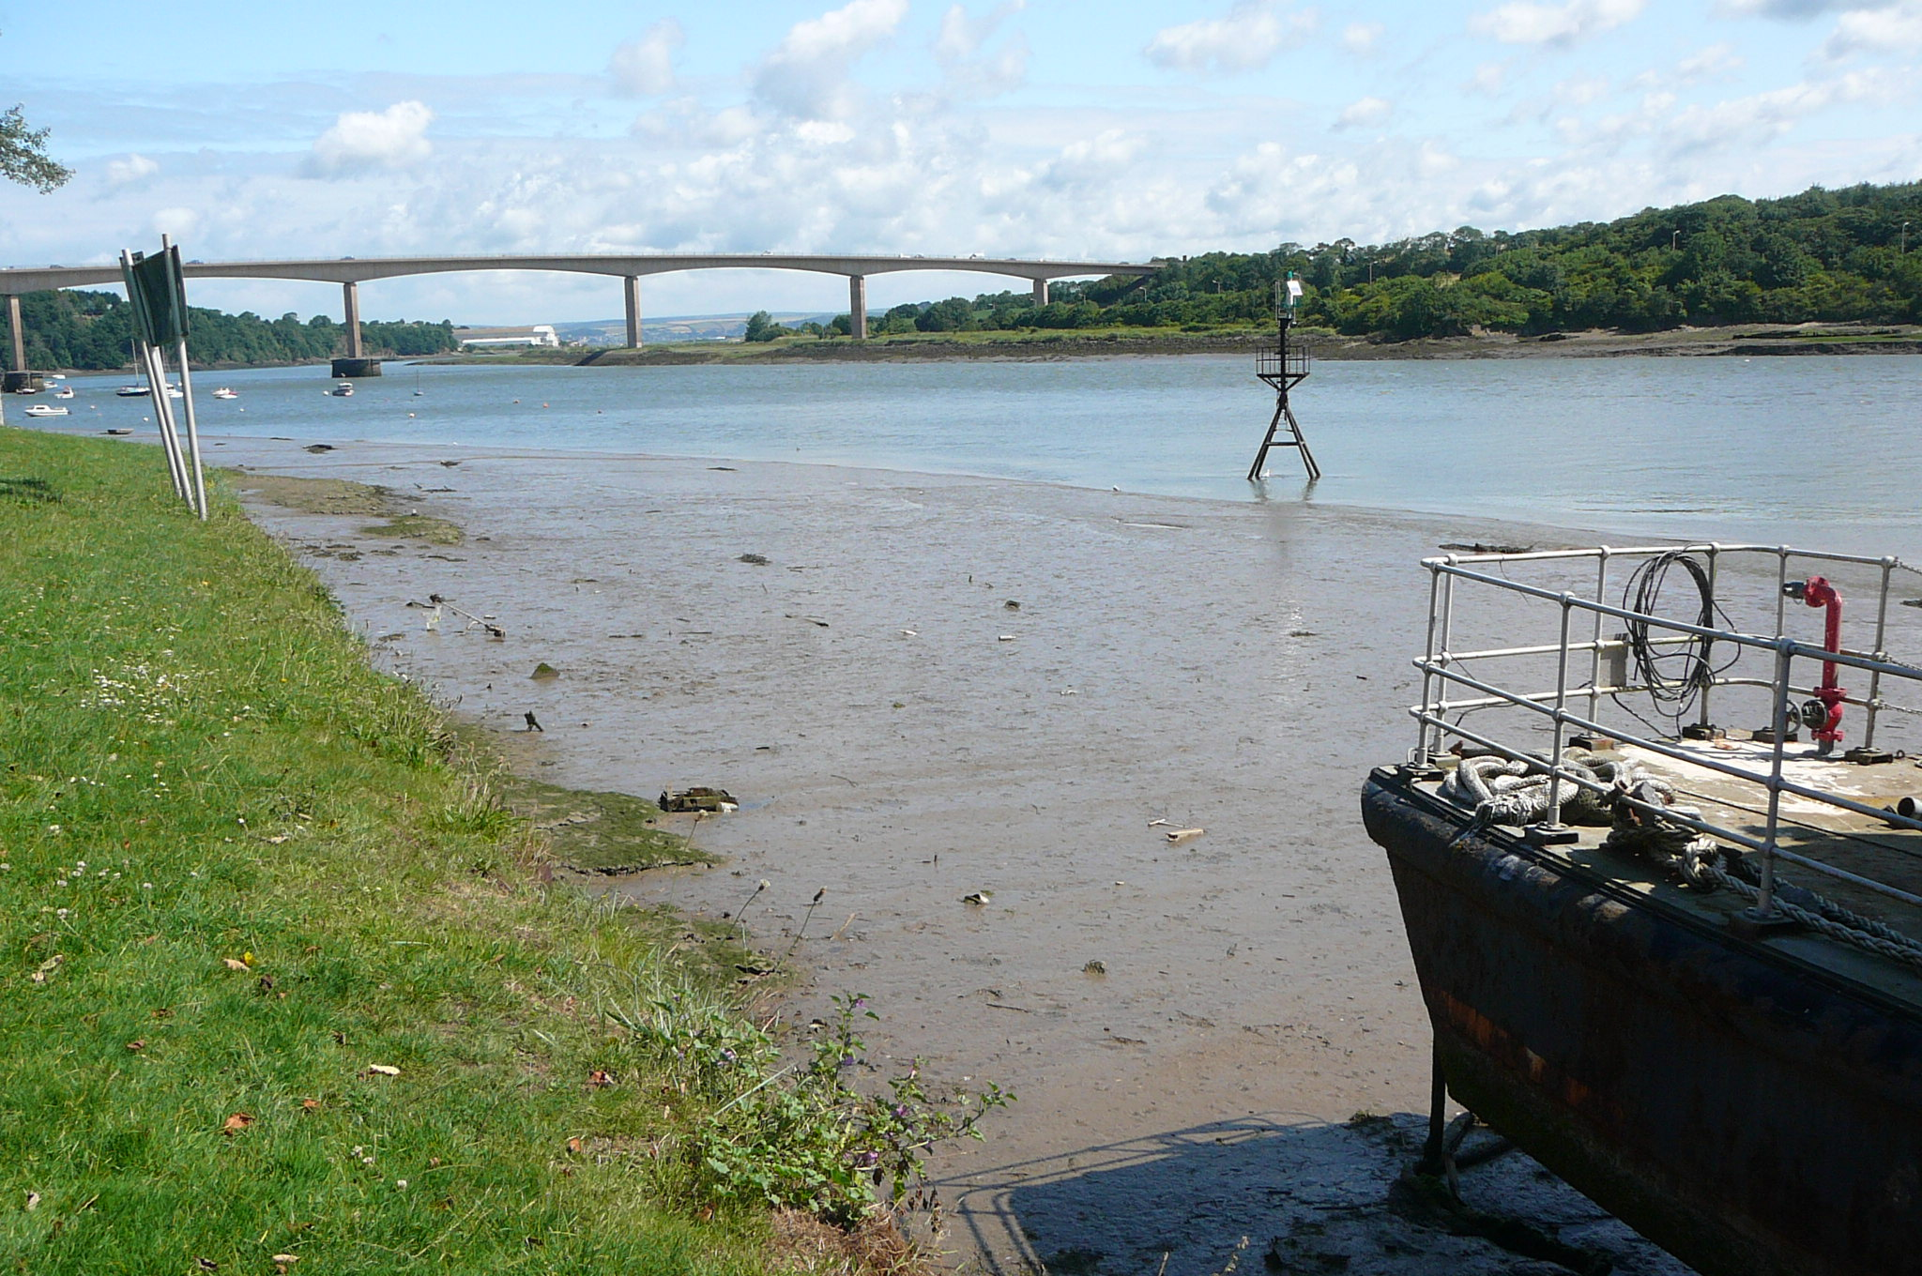

Slide 17
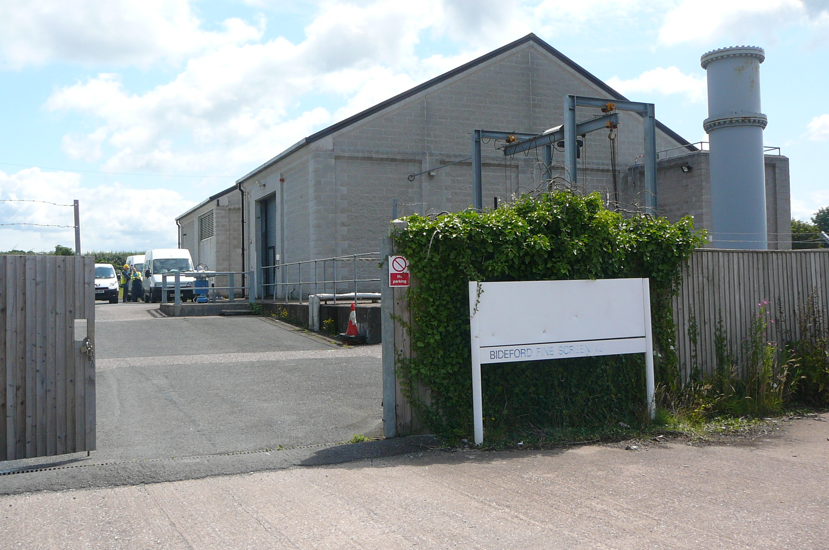

Slide 18
Public Enquiry Statement
A local doctor has been heard to say that of all the holidaymakers who stay here for a few days canoeing and windsurfing and using the estuary for similar sports, 75% contract an ailment that needs treatment. [9 doctors from the Wooda Surgery serving the Bideford area had expressed their concern with the present situation.] Bideford Chemists prepare for the tourist season as if for a campaign. The chemist in Mill St displays a window sign, advertising his cure for diarrhoea.

Slide 19


Slide 20
And in spite of their conditioning the local population does not escape. In general, they complain of an endless grumbling epidemic of throat and chest complaints and stomach disorders. In the 1984 tourist season 200,000 visited Bideford […] The effect of the estuary’s pollution on the state of mind of the local residents, is subjective and elusive. However, this depression is very real. Local people can feel in their bones that the whole situation is depressing […] And this depression accumulates. But it can be picked up quite quickly. You do not have to be a superclean German or American to decide, after one good look at the sludge, that the Torridge Estuary is no place for a holiday.
Emory MSS 644, Box 170, FF 1.

Slide 21
‘If’
If you have infected the sky and the earth
Caught its disease off you – you are the virus
If the sea drinks the river
And the earth drinks the sea
It is one quenching and one termination
...

Slide 22
Where will you get a pure drink now?
Already – the drop has returned to the cup
Already you are your ditch, and there you drink

Slide 23
Activism and Art for Water
Torridge Action Group, 1981
River, 1983
River Creedy Campaign, 1992
Rain-Charm for the Duchy, 1992
Southwest Water gives £5,000 to research detergents in the River Exe, 1992
The Iron Woman, 1993
West Country Rivers Trust, 1995

Slide 24
‘Every new child is nature’s chance to correct culture’s error.’
Winter Pollen (1994: 149)

