Slide 1


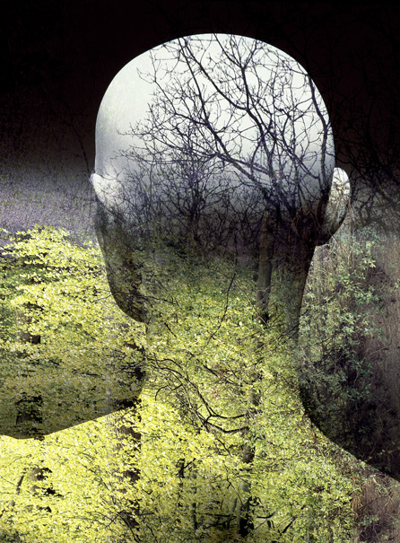

Health, Literature and Ecology
Professor Paul Crawford

Slide 2

Health Humanities: The evolution of Medical Humanities
A more inclusive, outward-facing and applied discipline
Not just medical
Relevant to allied health professionals, carers, service-users, self-carers
Building innovative collaborations between health humanities, sciences, and social sciences

Slide 3
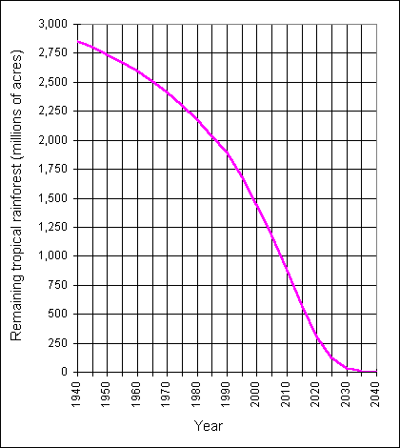
The need for cross-disciplinary research
How have the natural sciences influenced the representation of healthy/unhealthy environments in literature?
Conversely, in what ways have cultural perspectives on health and ecology shaped the mission and development of science?
To what extent does human health figure in literature addressing biodiversity, climate change, pollution, sustainability etc?

Slide 4
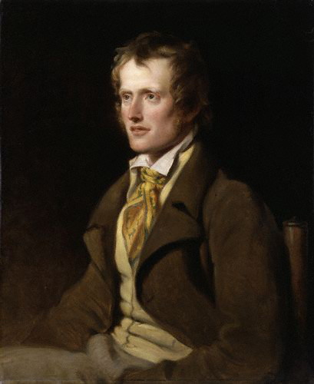
John Clare
‘Ah sure it is a lovely day/ As ever summer’s glory yields/ And I will put my books away/ And wander in the fields’ (‘A Morning Walk’).
‘…flowers join lips below and leaves above/ And every sound that meets the ear is love’ (‘A Spring Morning’)
‘The very road that wanders out of sight/ Crooked and free is pleasant to behold/ And such the very weeds left free to flower/ Corn poppys red and carlock gleaming gold’ (‘Pleasant Spots’)

Slide 5
Ugly transformations
‘Inclosure came, and every path was stopt,/ Each tyrant fixt his sign where paths were found,/ To hint a traspass now who cross’d the ground’ (‘The Village Minstrel’).
During the later years, Clare’s landscape becomes fleeting, fragile, and lost to the past:
‘The Apple Top’t oak in the old narrow lane/ And the hedgerow of bramble and thorn/ Will ne’er throw their green on my visions again’ (‘The Round Oak’)

Slide 6
Growing strangeness
‘The Flitting’
I’ve left mine own old home of homes
Green fields and every pleasant place
The summer like a stranger comes
I pause and hardly know her face…
I sit me in my corner chair
That seems to feel itself from home
I hear bird-music here and there
From awthorn hedge and orchard come
I hear, but all is strange and new…

Slide 7
Identity challenged
Final stanza of ‘I am’:
I long for scenes where man hath never trod
A place where woman never smiled or wept
There to abide with my Creator, God,
And sleep as I in childhood sweetly slept,
Untroubling and untroubled where I lie
The grass below – above, the vaulted sky.

Slide 8

  www.healthhumanities.org

