Slide 1

Borrowing the World from our Children
Gender, Posterity and Well-being in the Climate Change Novel
Adeline Johns-Putra
University of Exeter

Slide 2
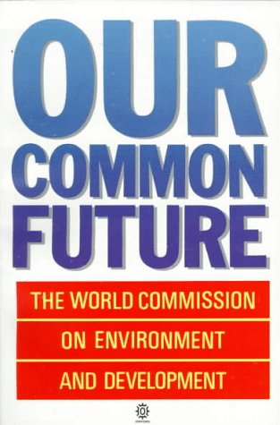
Sustainable development is development that meets the needs of the present without compromising the ability of future generations to meet their own needs.
The World Commission on Environment and Development, Our Common Future (Oxford: Oxford University Press, 1987), p.43.

Slide 3
Ruth Padel, ‘Slices of Toast’
I think of James Lovelock’s face, after he’d given
his lecture explaining that most of this planet,
fifty years from now, will be underwater
beginning with Bangladesh, at the top
of the Bay of Bengal. Those tangled mangrove swamps
of Sundarbans, paradise for herons, king cobras,
honey-gatherers, fishermen, will no longer protect.
The hundred mouths of Ganges, plus sea
rising to meet the melt from Himalaya, will finally
swallow that land. All those wars, India,
Pakistan, the intricate woeful mud pie
of human history, will no longer matter
for Shiva will not be catching Ganga in his hair.
And a woman in the auditorium asks: If all you say
is true, what should we be teaching our children?
Now that was a question Mr Lovelock, you could see,
hadn’t faced before, and his shoulders sagged.
I don’t know. I really don’t know. But if all
he said is true, the only answer is commando skills.
Fight to the death for any high ground you’re standing on
my darling. I think of John Wyndham’s The Kraken
Wakes. The window rattles again; rattles louder.
It’s getting closer, faster and faster, whatever’s outside,
and I know the Thames Barrier, small waters
of our particular rivers, and this terrible readiness
to worry about your own family first, may be the least
of our problems but I think my daughter, my daughter,
how is she going to deal with this?

Slide 4
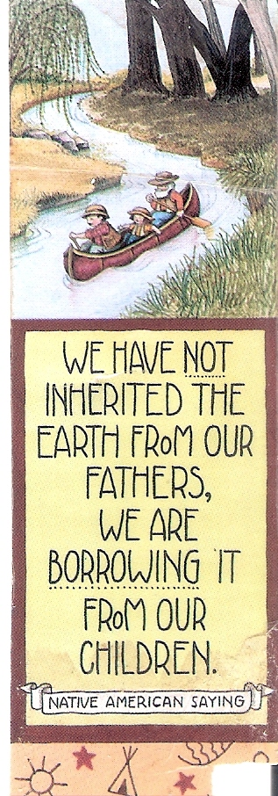

Slide 5
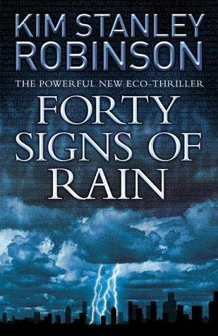
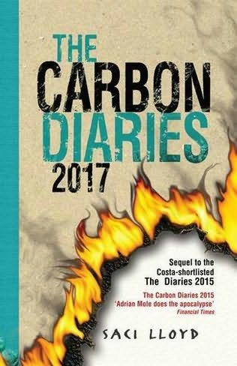
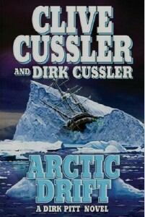

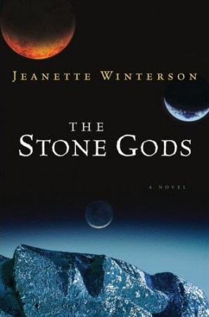
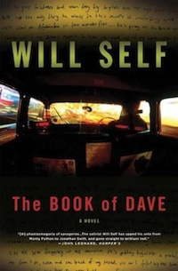
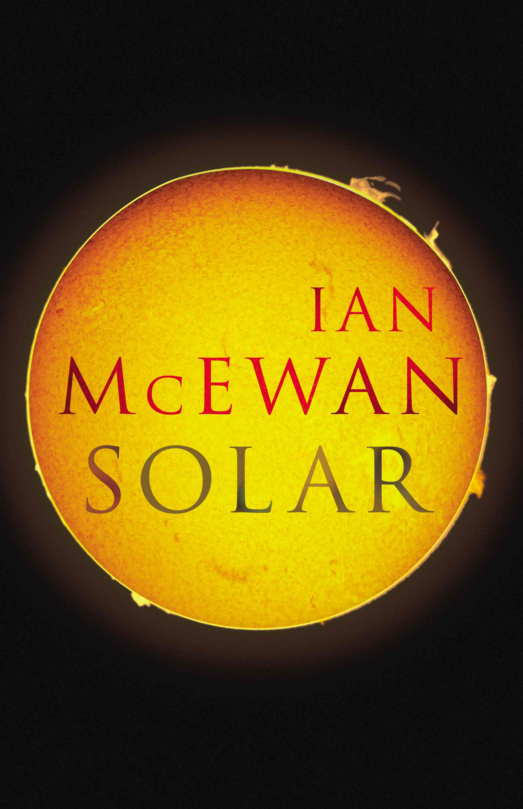
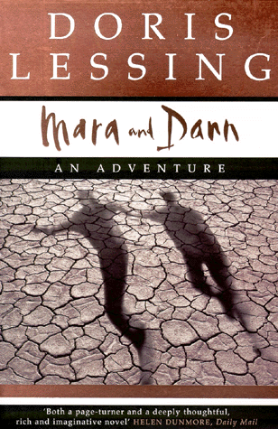
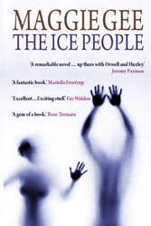
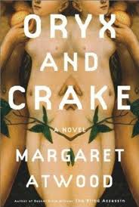

Slide 6
“A partnership ethic of earthcare means that both women and men can enter into mutual relationships with each other and the planet independently of gender”.
Carolyn Merchant, Earthcare: Women and the Environment (New York: Routledge, 1996), p.217.

Slide 7
“The line between empowerment and paternalism is as difficult to identify as the boundary between guidance and domination, although these relations might all be labeled ‘caring’”
Chris J. Cuomo, Feminism and Ecological Communities: An Ethic of Flourishing (London: Routledge, 1998) p.129

Slide 8
“women’s skills developed beyond her famed endurance and purveyance of care and wellbeing. She learned the ways of plants. She learned the ways of other creatures of the land, air and sea. She learned them in a spirit of recognition and respect. And with a similar spirit, she partook of them”
Andrée Collard with Joyce Contrucci, Rape of the Wild: Man’s Violence against Animals and the Earth (London: The Women’s Press, 1988) 11
“Pregnancies and child-bearing … are a woman’s link to the natural world and the hunted animals that are part of that world”

Slide 9
“the actuality of caring for the concrete needs of others gives rise to a morality of relatedness among ordinary women, and this sense of kinship seems to extend to the natural world”
Ariel Salleh, “Class, Race, and Gender Discourse in the Ecofeminism/Deep Ecology Debate”, Postmodern Environmental Ethics, ed. Max Oelschlaeger (Albany: State University of New York Press, 1995), p.82.
“social construction and essentialism are not necessarily opposed concepts”
Catriona Sandilands, The Good-Natured Feminist: Ecofeminism and the Quest for Democracy (Minneapolis: University of Minnesota Press, 1999), p.71.

Slide 10
“There is nothing about being ‘female’ that naturally binds women. There is not even such a state as ‘being’ female, itself a highly complex category constructed in contested sexual scientific discourses and other social practices.”
Donna Haraway, “A Cyborg Manifesto: Science, Technology, and Socialist-Feminism in the Late Twentieth Century”, Simians, Cyborgs and Women: The Reinvention of Nature (London: Free Association Books, 1991), p.151.
“But the ground of life? What about all the ignorance of women, all the exclusions and failures of knowledge and skill? What about men’s access to daily competence, to knowing how to build things, to take them apart, to play?”

Slide 11
She is all States, all Princes I

Slide 12
“But there she is, sun-warmed, rain-cooled, moon-worshipped, flanked by the stars. There she is. Planet Blue” (84)
“women are just planets that attract the wrong species” (69)
“We are solar-powered and self-repairing. We are intelligent and non-aggressive” (79)
“Humans always assumed that theirs was the only kind that mattered. That’s how you destroyed your planet” (79)
“I can’t wipe out the yes. One word, and a million, million worlds close. One word, and for a while there’s a planet in front of me, and I can live there” (83-84)
“It is not a universe, there is more than one reading. The story won’t stop, can’t stop, it goes on telling itself, waiting for an intervention that changes what will happen next. Love is an intervention” (83)

Slide 13
“That one thing should stand for another is no harm, until the thing itself loses any meaning of its own” (136)

Slide 14
“perhaps I have to say that the landing-place I am really looking for isn’t a place at all: it’s a person, it’s you. It’s the one place they can’t build on, buy or bomb because it doesn’t exist anywhere they can find it” (200-01)
“I think all my life I’ve been calling you, across time. Steadily sending the signal, sure that, one day, you will hear” (220).
“I use […] the idea of eternal return—not in the Buddhist sense, but in the sense of endlessly making the same mistakes”
Qtd. in Sonya Andermahr, Jeanette Winterson (Basingstoke: Palgrave, 2009) p. 131

